Slide 1
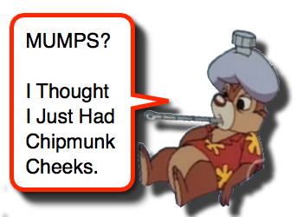
Mumps
Outbreak 2018

Slide 2
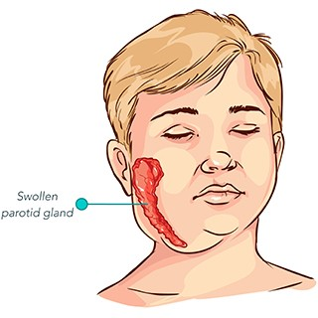
What is Mumps?
Mumps is an infection caused by the mumps virus
The infection can cause fever, headache, and swelling glands around the jaw and cheeks.
Cause meningitis; About 1/10 people with mumps gets meningitis.

Slide 3
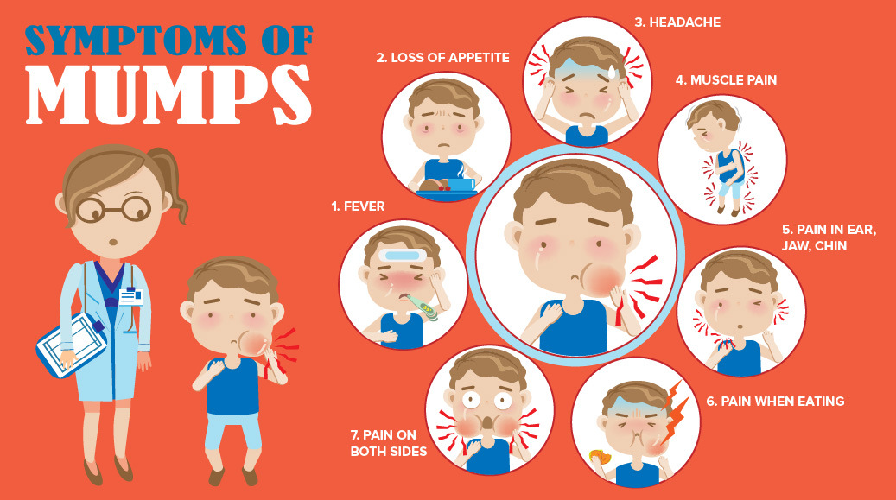
Signs and Symptoms

Slide 4
When are you Contagious
Individuals are infectious up to seven days before and five days following swelling of the salivary glands
Incubation period can range from 12 to 25 days

Slide 5
At Risk
Immunocompromised
People born after 1970 and before 1983
Children under the age of 1
Pregnant women in first trimester

Slide 6
Risky behaviours
Living in close quarters
Participation in sporting events
Kissing, coughing, and sneezing
Sharing food, drinks or eating utensils
Sharing toothbrushes, mouthguards, towels, cigarettes, or lipstick
Sharing Mouthed toys or musical instruments

Slide 7
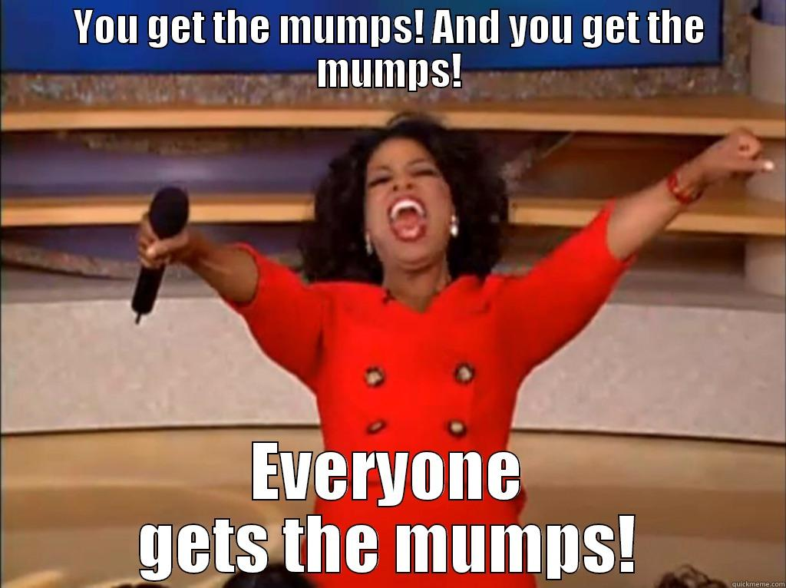

Slide 8
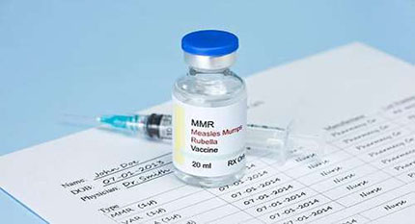
Prevention
2 doses of mumps vaccine
Reduce exposures to others mouth and nasal secretions…i.e stop sharing
Wash hands well and often

Slide 9
When to isolate with droplet precautions
Known exposure with unknown immunity
  Isolate 12 days after exposure up to day 25
Suspected/known case
  Pts with signs and symptoms of mumps are isolated up to 5 days after onset of symptoms

Slide 10
Testing
Preferred method for diagnosis is PCR or culture
  Submit CSF, urine, or a buccal/throat swab in UTM for PCR test
  Serology is not recommended routine diagnosis as many have been immunized and a negative IgM can not rule out an active case

Slide 11
Testing
Please follow the instructions below for choice of specimens:
Oral specimens:
  Throat, nasopharyngeal, saliva, buccal swab or swab around the Stensen’s duct.
  Collect within 5 days of onset of symptoms. Place swabs in M4 viral transport medium.
Urine:
  Collect ~ 50 ml clean catch urine in sterile dry container.
Blood:
  Collect blood in serum separator tube

Slide 12
Posted in Emergency Department

Slide 14
Treatment
Treatment is supportive only
  Antipyretics for fever and discomfort
  Bed rest
  Drink lots of water
  Stay away from acidic food and drinks

Slide 15
History of mumps and Vaccination in Canada
Before Vaccine 30,000 cases Annually in Canada.
1980-81 detailed study of mumps was carried out in Alberta
  During one year period 1/6 susceptible children was infected with mumps.
Before mumps vaccination programs began in early 1970’s mumps was the most common cause of encephalitis in children.
Mumps not common in NL due to high immunization rates.

Slide 16
Current Outbreak
As of February 1, 2018 there has been 22 cases of mumps noted in EH.
96% of 2 year olds were immunized with 2 doses of MMR.

Slide 17
When the staff Nurse has mumps!!!
Don’t panic
Line list of patients that were in contact over past 7 days
  Note year of birth and mumps history or immunization status if known
Contact OHN who will need list of staff that also worked with nurse during infectious period
Make sure nurse has had testing done and MOH is notified
All health care workers not vaccinated or refusing vaccination have to be off work from day 12 to day 25. Those that have the two MMR can continue to work

Slide 18
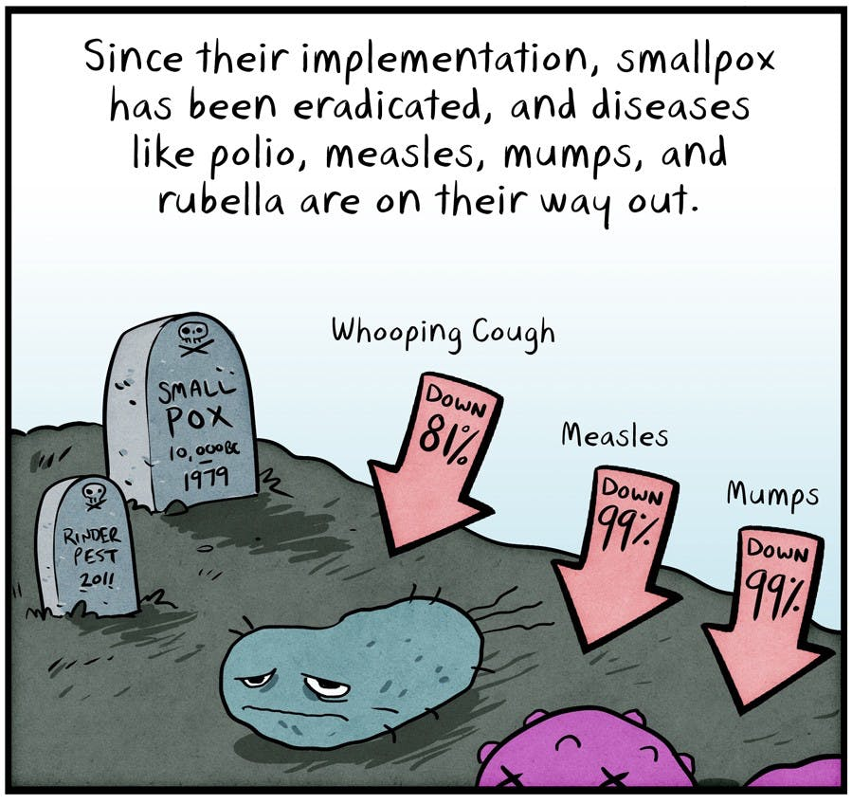
Questions

